Slide 1
Python and MySQL Useful for Data Cleaning?
Zackary Gill
Mai Loan Tran
Notes:
Requirements & Problem – 5 minutes
Solution Approach – 10 minutes
Initial Design
Development Issues
Revised Design
Demo
Conclusion – 3 minutes
Q&A

Slide 2
Requirements
Control travel and reimbursable costs
spend analysis
management reporting
vendor negotiations
Notes:
My employer, like most businesses needs to control costs. One of the areas that I am responsible for is travel and reimbursable expenses.
In order to control these expenses, we need to track where these costs are incurred.
Our accountants records the multiples sources of these transactions as journal entries into an accounts payable ledger.
A SQL database was recently created to house a monthly extract of the travel and reimbursable expenses entries.
In order for these entries to provide useful information for analysis, reporting, and vendor negotiations, we found that we needed to clean various attributes that are either from credit card or free text inputs.
One of these attributes that take the most time to clean is vendor names across 82 expense types.

Slide 3
Problem
More data sources = More data cleaning
Manual inspection > 1,009,303 tuples
Time and labor intensive
Missed values
Incomplete information
Notes:
The reason why it is most time and labor intensive is because the sources differ and vary in volume.
The more data sources, the more the variations in values, hence the more difficult to standardize the data values.
Using SQL select and update statements to standardize vendor name can take 2-3 days per month while still leaving vendor name inconsistencies and limited to higher spend expense categories such as airfare, hotel/lodging, and car rentals and leaving shoddy misspelled vendor names for meals and other expenses.
That is, the same vendor is not standardized across all reimbursed expense categories.
Furthermore, just because it is standardized for previous months transactions, it still needs to be updated for new transactions each month.
There are still missed values in the review along with null values.
As a class project, I wanted to know whether modifying the database schema and the data cleaning process using MySQL and Python could reduce the time it takes to clean this vendor name attribute.

Slide 4
Monthly Process
Notes:
The sources of data comes from users, known, and unknown vendors, that come in through expense reports, credit card transactions, and invoices globally that are accounted by accountants in various countries.
Representations of a vendor name range from 21,000 to 132,000 tuples or journal entries per month for these travel and reimbursable expenses.
There are mis-spellings from users and variations from different POS credit card processors, e.g. Starbucks.
If you go to different Starbucks across a metroplex, country, or internationally, and use the same credit card, Starbucks is not reflected the same within your credit card statement.
The same goes for airlines, a major expense, which I will show you an example a little bit later.

Slide 5
Monthly Process (cont.)
Notes:
All of these travel and reimbursable expense transactions either automatically flow through into our Account Payable sub-ledger or inputted by an Accountant.
These transactions are then extracted for my department’s focus.

Slide 6
Monthly Process (cont.)
Monthly Process (cont.)
6
Notes:
The current workflow requires that I...
Query to select values by expense type and LIKE vendor names
Manually inspect values for variations in spellings, etc.
Write SQL update statements for each variation
We started this project with 1,009,303 rows

Slide 7
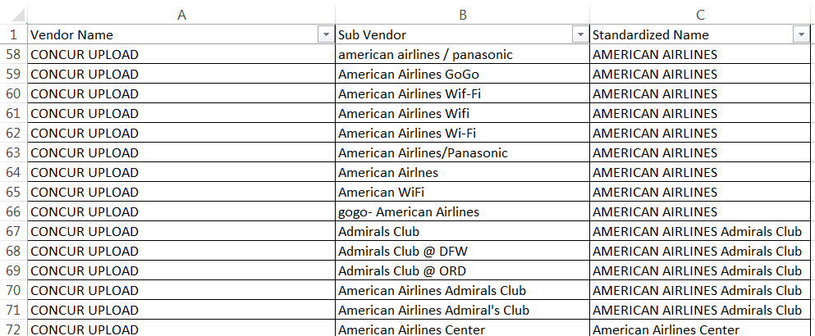
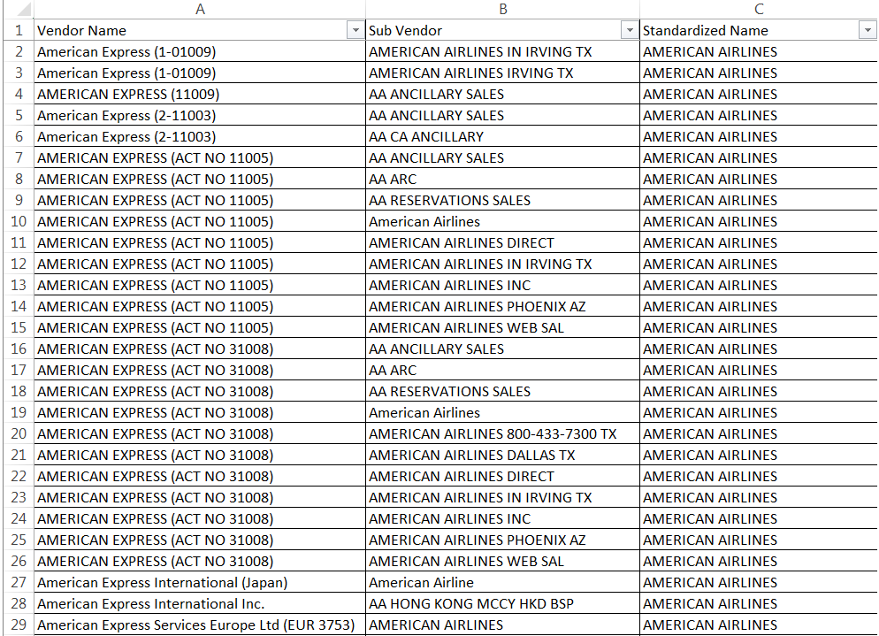
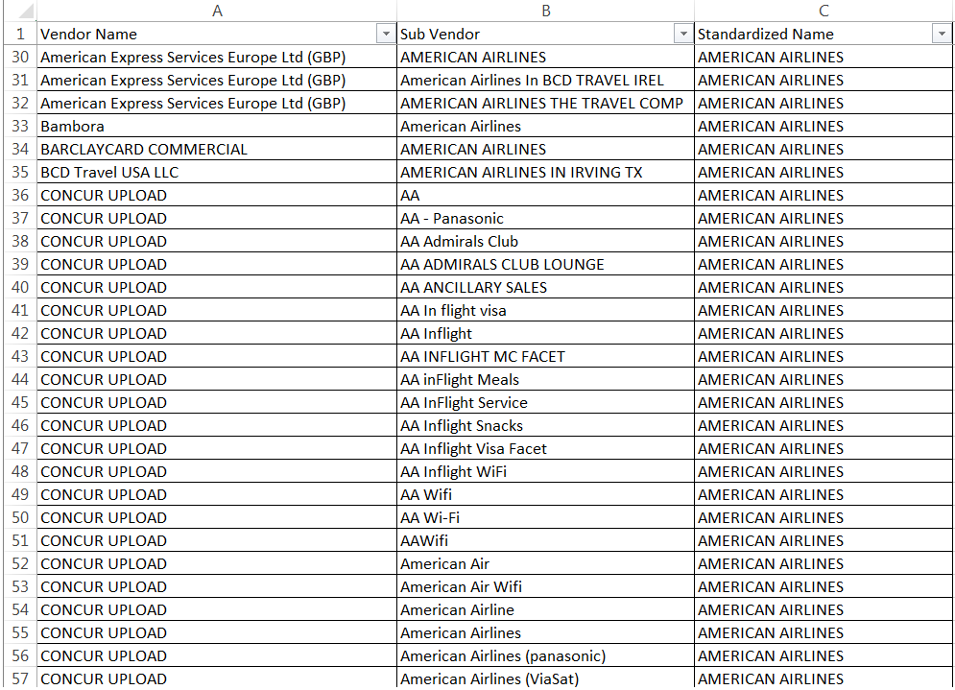
Example of Variations
Example of Variations
104 variation for “AMERICAN AIRLINES”
7
Notes:
Of the million plus and increasing number of transactions, we have at last count a little over 22K unique vendor names in the database going back to 2017
At the start of this semester, I had 71 variations for AA. I now have 104 spellings and representations.
So we explored how can this process be improved?

Slide 8

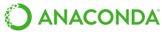

Setup
MySQL
Anaconda
Manages libraries
Python
Pandas
mysql.connection
difflib
Notes:
We needed to create a repeatable method to clean and standardize the vendor data. For this we decided to use MySQL to house the data and do all the data manipulation within python.
For python, we decided to use Anaconda to manage our installed libraries and packages. This decision was especially important because our project is solving a real world problem, and we want the setup to be easily replicable. In Anaconda we created a new environment and installed the appropriate minimal libraries required including pandas and mysql.connection.

Slide 9
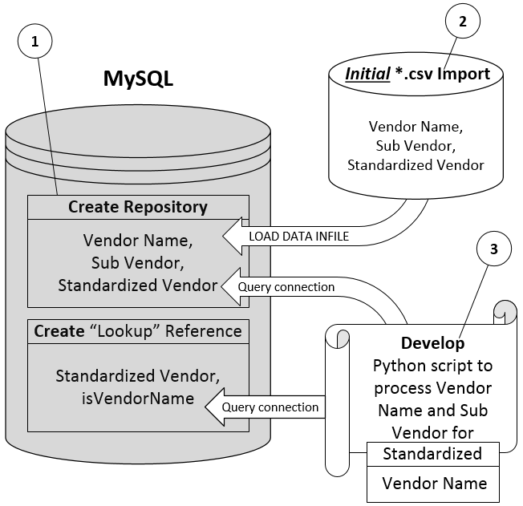
Initial Solution
Lookup table
Houses standardized vendor names
Import standardized values into “lookup” table
Python
Reference the “lookup” table and use a ‘spellcheck’ to populate the standardized entries
Ex: American Airlines
‘merican Airlines
American Airlines INC.
‘merican Airlines INC.
Notes:
In our first presentation, in a nutshell, the workflow of the solution was to first create a lookup table. We import any and all previously created valid entries into that table. Next we have a python script that references the lookup table and automatically finds, matches, and then inserts valid entries back into the standardized name field. There are 3 possible ways to make erroneous entries, you can see them the example on the slide, and we wanted to use some sort of ‘spellcheck’ function to fix them.

Slide 10
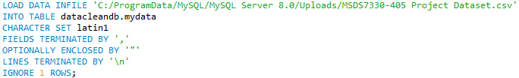
Development Issues
MySQL
Loading CSV
Data Language
Python
Cursor + Panda’s “read_sql”
‘Spellcheck’
Notes:
During our development we had some issues loading data from CSV into MySQL so we used the LOAD command instead of the built in import wizard, it was incredibly quick. Our data is in many languages so we had to change the ‘character set’ to match. Within python, we found that we had to use a combination of ‘cursor’ and Panda’s functions for updating, selecting, and creating tables. We decided to discard our ‘spellcheck’ idea because with further research we found that it was quite complex and that falls more under the category of Natural Language Processing (which is way outside the scope of this project). Just writing up the outline and doing more research of this type of problem caused us to revise our design.

Slide 11
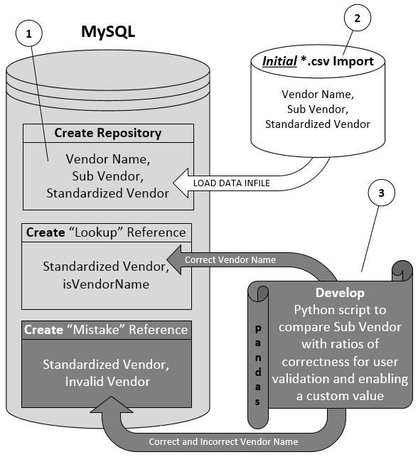
Revised Solution
Added ‘Mistake’ table
Pairs standardized values with misspellings
Hybridized approach
Python
difflib
Ratio: 0 to 1
1 is a perfect match
Notes:
We still kept the data housed in MySQL and have a Lookup table, but we added a second table, what we called the ‘mistake’ table. This table has valid entries paired with mistakes. We added this table because we decided to emulate a popular solution which is to pair a valid entry, like “Starbucks”, with all the common misspellings. The issue with going directly with that solution is that the scope of possible valid entries is relatively infinite. Because as Mai Loan mentioned, the valid entries could be any company in existence, in any country. This is why we went with our hybrid approach.
Because we discarded ‘spellcheck’ we instead we used a library called ‘difflib’ that has a function that compares two strings and outputs what’s called a ‘ratio’ of how close they are to each other. The value is between 0 and 1, with 1 being a perfect match.

Slide 12
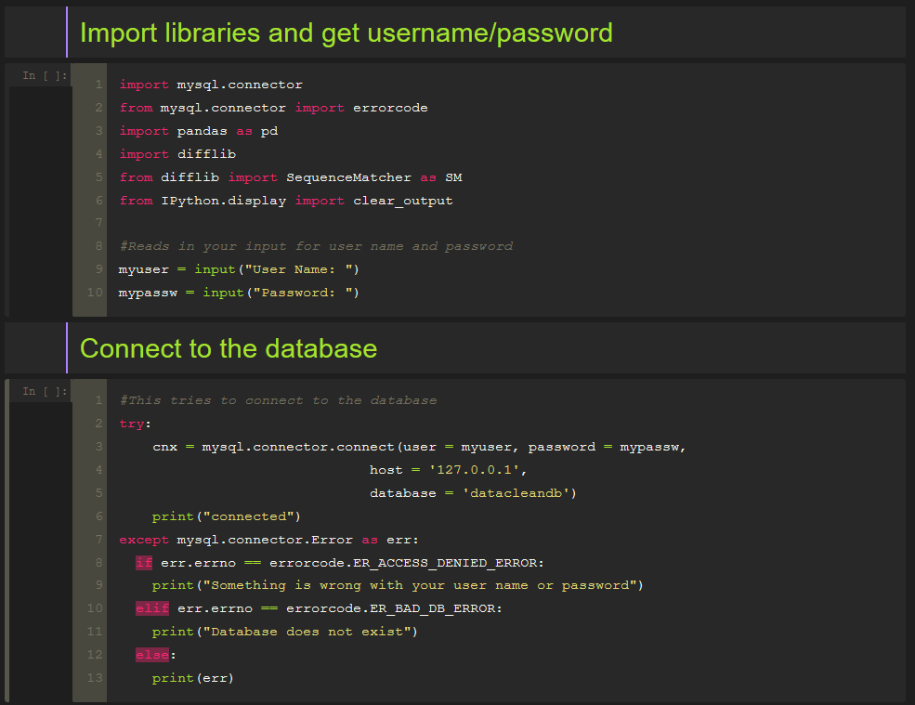
Demo Connecting to MySQL
Notes:
Now I will move on to a demo of our solution. The solution is comprised of around 400 lines of code. For a computer scientist this is nothing, for a data scientist… AHHH.
Now the whole project was made to be run from inside Jupyter Notebook. To make a decent command line GUI we used clear_output() before drawing each screen.
First you have to connect to the database. I have that as a separate function to run first and just in case something goes wrong so you can deal with it not and have it not interrupt the program half way through.
And yes these are just screenshots, I am not running it live because Murphy’s Law is always in effect during presentations.

Slide 13
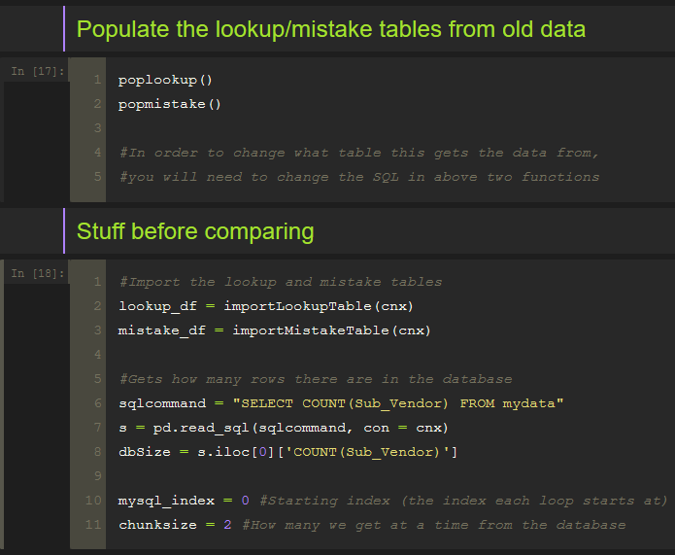
Demo Populating Lookup and Mistake Tables
Notes:
Now hitting run will first populate the mistake and lookup tables within MySQL, then it will import those tables into Python using the Pandas library. They are saved as a dataframe.
By the way, after the demo is completed I will show you a snippet of what the three tables look like.
When getting the raw data that needs to be cleaned from MySQL, the user can specify how many rows at a time will be imported. During testing we simply got 2 at a time.

Slide 14
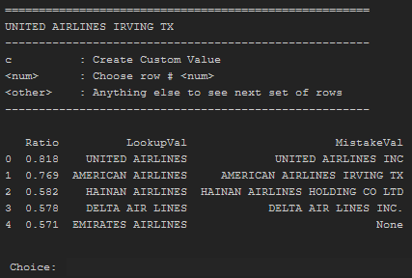
Demo Overview of Main UI 1
Notes:
Here you can see the first value to standardize: “UNITED AIRLINES IRVING TX”.

Slide 15
Demo Overview of Main UI 2
Notes:
The lower half of the screen contains the values from the lookup and mistake tables. If there were no values present within the Lookup and Mistake tables this would be blank.

Slide 16
Demo Overview of Main UI 3
Notes:
As you can see they have been ordered by the value of their “Ratio”, (which is their similarity to the value to standardize).

Slide 17
Demo Overview of Main UI 4
Notes:
LookupVal is a standardized value from the lookup table

Slide 18
Demo Overview of Main UI 5
Notes:
and MistakeVal is a mistake that was previously paired with the LookupVal.

Slide 19
Demo Overview of Main UI 6
Notes:
For example, you can see in row number 1 someone typed in American Airlines Irving TX, but the standardized value is actually American Airlines

Slide 20
Demo Overview of Main UI 7
Notes:
In the bottom case you can see that there is no mistake value for Emirates Airlines. This indicates that the “Emirates Airlines” string is closer in value to “United Airlines Irving TX” than any of mistaken spellings of “Emirates Airlines”.

Slide 21
Demo Overview of Main UI 8
Notes:
So now that we have this output you have three options. You can type in:
c if you wish to create a custom valid value. You would do this if none of the values in the LookupVal column are ones that you wish to choose.
If you type in a number and you will choose a LookupVal based on the row number on the left. For example if you typed 0, you would be choosing United Airlines.
If you type in anything else it will show the next 5 rows.

Slide 22
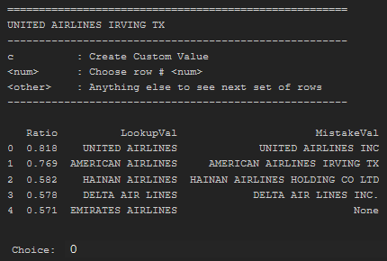
Demo Overview of Main UI 9
Updates all with exact spelling because update is not on Primary key
Notes:
In this instance type in 0 (which is the correct value for United Airlines Irving TX to be standardized to) and it will automatically add “United Airlines Irving TX” to the mistake table and update the row in MySQL. The way that this is set up, the update will not simply update the single row, it will update all rows that contain this exact value. Update works in this way because we are not updating on a primary key.
Whenever there is a ratio match that is a perfect 1 for either the Lookup or Mistake values, the program automatically updates all the tables with the correct value and moves on to the next one without any user interaction.

Slide 23
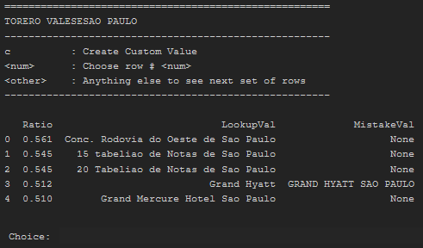
Demo 2 Main UI
Notes:
The next value to standardize is Tore-air-o …. yeah I can’t pronounce that.
For this one you can see that there are no values that seem to be a good standardized value. This is also pretty apparent by seeing that the highest ratio is only 0.561. Just for the sake of being thorough, we type in something random to look at the next 5 rows.

Slide 24

Demo 2 Second Page of Main UI
Notes:
You can see that these values look even worse than the first 5. With a ratio of 0.5 “Four Seasons” is the closest match. So we will instead make a custom value for this.

Slide 25
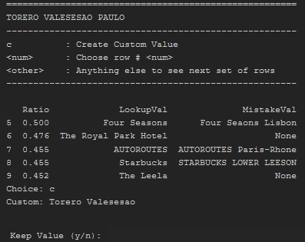
Demo 2 Custom Value UI
Notes:
We type in the custom value and type ‘y’ to keep it.

Slide 26

Demo 2 Custom Value Confirm UI
Notes:
Next the program pulls up this screen and checks the newly typed value against the Lookup and Mistake tables, just to make sure the value that we typed does not match something already in the table. As you can see, the closest match is “The Leela” which is not even remotely close, so there are no values that seem to match. We could move on to the next 5 but that doesn’t seem necessary.
At this point we have decided that we like our custom value so we type ‘c’. It uses the custom value and just like before in the previous example it creates a new entry in the lookup and mistake tables and updates the values in MySQL.

Slide 27
Demo 2 Side Note
Notes:
Now as a side note, you can see that because we generated the lookup and mistake tables from previously created data that was manually entered and manually validated, you can see a typo in row 3 (“Four Seasos”) compared to row 1 (“Four Seasons”), which highlights the need for this system.

Slide 28
Conclusions
Database schema change
Two (2) new reference tables: Valid and Invalid Values
UI to clean data
Ratio assignment for comparisons
Supports custom values
Notes:
The conclusions we reached are the same as our lessons learned from this project
By modifying the database schema with two rather just one reference table and Python logic to track not just valid but also invalid values, it is foreseeable that this would increase the accuracy of the data values across all spend categories.
A UI to build the repository with automated repeatable comparisons provides a non-technical resource a tool to perform the data quality function a the user does not need to know SQL.
Automated ratio computation for similar spellings narrows down the values for selection and standardization thus reducing manual inspection time while allowing for custom values.

Slide 29
Conclusions
No immediate reduction in time & labor
Longer-term reduction
Integrating a database with a programming language
An intricate matter
Notes:
No immediate reduction time & labor because we still needed to review and populate the values in both reference tables one at a time for each of the unique 22,513 vendor name variations
However, it is expect that the schema changes to track the values in both these tables would be reused to cut down inspection of future monthly entries for longer term reduction
No metrics at this point in time until values completely populated in both reference tables
Nevertheless, the knowledge gained from this project showed us the intricacies of integrating a programming language, specifically, Python with a relational database
Project provided experience in the importance of understanding requirements upfront in designing relational database schemas and its attributes, e.g. a reference table with both valid and invalid values, changing our starting point from raw data to the dataset with as much cleaned data as available
Importing data (table import wizard is super slow)
Importing data to MySQL (char set, import speed)
Speed of querying a database vs a data frame (database are optimized, data frames are not) try-catch (prevent crashes and get output from failed connection) cursor (for doing operations on a database) connectors (can be switched out for another one) Sanitize SQL queries (be careful of ' and such characters if concatenating strings in python)

Slide 30
Questions?

